Slide 1
Variable Capacitance Transducers: -

Slide 2

Capacitive Transducers: -
The Principle of operation of capacitance transducer is based upon familiar equation for capacitance of a parallel plate capacitor
$C={∈∗A}/d={∈_{0}∗∈_{r}∗A}/d$ F

Slide 3
Where
A is the overlapping area of plates (in m²)
d is the distance between 2 plates(in m)
Ɛ is the permittivity of the medium(in F/m)
Ɛ_{r} is relative permittivity of the medium(in F/m)
Ɛ_{o} is permittivity of free space(in F/m)

Slide 4
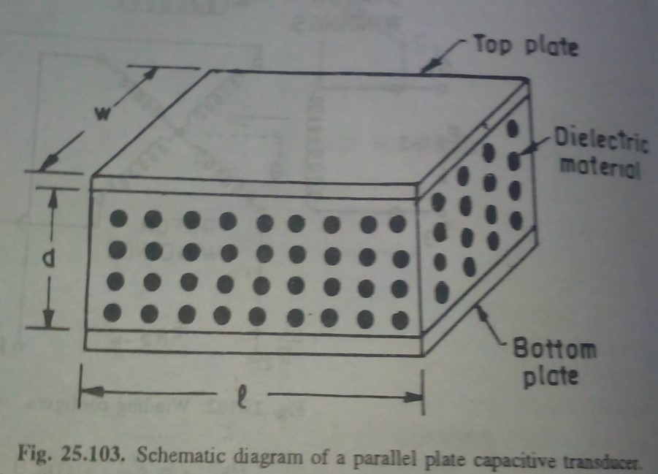

Slide 5
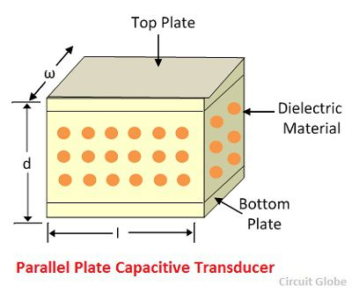

Slide 6
Capacitive Transducer works on the principle of change of capacitance which may be caused by: -
Change in overlapping Area A
Change in distance d between the 2 plates
Change in dielectric constant

Slide 7

These changes are caused by physical variation like distance, force and pressure.
Capacitance of a capacitor may be measured using bridge circuits.
Output Impedance of capacitive transducer
$\text{X}\text{c}=1/{(2∗π∗f∗C)}$ Ohms
where C is the capacitance (in F) and f is the frequency (in Hz).

Slide 8
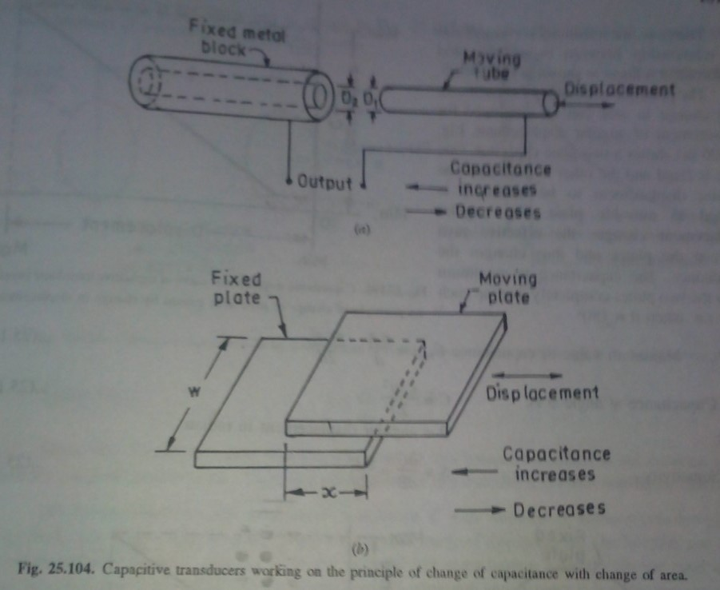

Slide 9
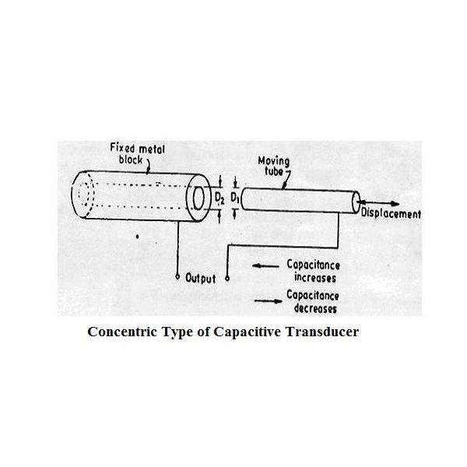

Slide 10
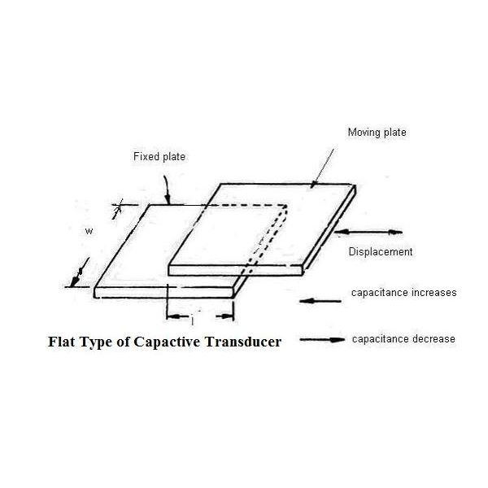

Slide 11

It is formally used for linear displacement measurement. These transducers use of following effects: -
Change in Capacitance due to change in overlapping area of plates.
Change in capacitance due to change in distance between 2 plates.
For a parallel plate capacitor,
$C={∈∗A}/d={∈∗x∗w}/d$ F
where x is the length of overlapping part of plate(in m), w is the width of the plates(in m).

Slide 12

The sensitivity of the displacement is constant, and therefore it gives the linear relation
between the capacitance and displacement

Slide 13
The End

Slide 14
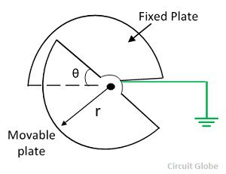
The capacitive transducer is used for measuring the angular displacement. It is measured by the movable plates shown below. One of the plates of the transducer is fixed, and the other is movable

Slide 15
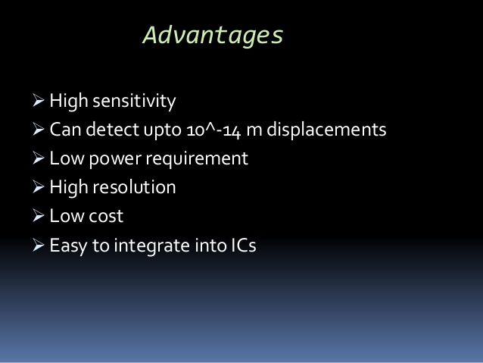

Slide 16
